Slide 1
ビジュアルナビゲーションの
ための画像の対応付け方法
大矢グループ i-ROBOT
Helio Perroni Filho
Notes:
Good morning everyone, I am Helio Perroni Filho and this is my presentation on Image Stream Synchronization for Visual Navigation.

Slide 2
自律走行について「教示・再生」
例示によりロボットに経路を教える
プログラミングより簡単
訓練されているオペレータは要らない
出
発
点
オペレータ
目
的
地
「教示」ステップ
（人が経路上を操作）
1.
ロボット
2.
「再生」ステップ
（自律走行）
ロボット
Notes:
Currently there is great interest in more intuitive man-machine interfaces for robotics systems, especially robots that can be configured by example, rather than direct programming. The appeal is that robots can then be configured by unskilled operators. This is called teach-replay.
For example, let's say we have an office courier robot to carry documents or supplies from one room to another. If our robot can do teach-replay, first we guide it through the route (what we call the “teach step”),and later, using information gathered along the route, the robot will retrace it autonomously (the “replay step”).

Slide 3
自律走行について「教示・再生」
視覚に基づく自律走行
画像
（「再生」ステップ）
ランドマーク
経路修正
「再生」ステップ
ドリフト
画像
（「教示」ステップ）
「教示」ステップ
カメラを使うのは色々な利点が有る：
  ロバスト
  コスト効率が良い
  手に入り易い
  人間に直感的
Notes:
A lot of work has been done on teach-replay, especially using cameras as sensors. Cameras have many advantages over other kinds of sensors: they are robust, cost-effective, ubiquitous and intuitive to humans.
Work in visual teach-replay navigation has often focused on appearance-based navigation, which uses differences in the appearance of selected landmarks to estimate differences in robot location between teach and replay paths, and effect corrections if necessary.

Slide 4
自律走行について「教示・再生」
DiVS:画像シーケンスから左右ドリフト認識
「再生」画像シーケンス
I'4
I'2
I'3
I'1
d4 = DiVS((I1, I'1), (I2, I'2), (I3, I'3), (I4, I'4))
I1
I2
I3
I4
ドリフト
「教示」画像シーケンス
再生の画像に対応する教示の画像を得るか？
I'1
I'2
I'3
I'4
I'5
I'6
「再生」ステップ
「教示」ステップ
I1
I2
I3
I4
I5
I6
I7
Notes:
Last time I presented the DiVS image processing method, which can be used to estimate drift by comparing the teach image sequence to the replay sequence collected up to the present moment. However, at that time not much attention was given to the problem of how such image pairs would be formed, with odometry data being used as a way to quickly validate the method.
Ideally, teach and replay image sequences should be paired visually: this would enable the whole drift estimation mechanism created around DiVS to work exclusively on visual data, without requiring input from any other kind of sensor. So the problem I investigate in this presentation is this: given two image sequences collected over the same route, but possibly at different locations along the route, how to pair them up so that viewpoints between images in each pair are as close as possible?

Slide 5
自律走行について「教示・再生」
対応画像の探索の関連研究
方法 | 参照 | センサ | 環境 | 変化
 |  |  |  | 照明 | 隠蔽 | 動物体
テンプレート照合 | [5] | 単眼カメラ | 屋内 | × | × | ×
コスト関数の最適化 | [6] | 単眼カメラ | 屋内 | × | × | ×
相互情報量 | [7] | 単眼カメラ | 屋内 | × | ○ | ○
特徴点の追跡 | [8] | 単眼カメラ | 屋内・屋外 | ○ | × | ○
局所最大の相性 | [9] | 単眼カメラ | 屋外 | ○ | ○ | ○
ステレオ特徴点の マッチング | [10] | ステレオカメラ | 屋内 | ○ | ○ | ○
平均ランドマーク ベクトル | [11] | パノラマ式カメラ | 屋内 | ○ | × | ×
オプティカル・フロー | [12] | パノラマ式カメラ | 屋内 | ○ | ○ | ×
本研究 |  | 単眼カメラ | 屋内・屋外 | ○ | ○ | ○
Notes:
Here I show some of the image pairing methods that have been proposed over the years – you can find the respective articles on my report's bibliography, these are their reference numbers. Unfortunately most of them fall short one way or another. A common limitation is for a method to only work indoors or outdoors. Difficulties on dealing with moving elements, such as people, or occlusions are also common. Some methods also require non-standard hardware, such as stereo or panoramic cameras.
Therefore, there is still demand for an image pairing method that works well indoors and outdoors, uses simple hardware such as a single monocular camera, and can deal with changes in lighting and the presence of occlusion and moving objects.

Slide 6
自律走行について「教示・再生」
対応画像の探索
本研究：「特徴点の相互相関」
画像シーケンスから安定な対応を作る
カメラ校正は要らない
照明変化・隠蔽面・動物体にロバスト
屋内も屋外も使える
Notes:
The limitations of current image pairing methods have motivated me to look for a new solution, which I call feature point correlation.
It works on image sequences, generating stable representations that are robust to changes in lighting, occlusions and the presence of moving elements. It is applicable to indoors and outdoors environments, requiring a single, uncalibrated monocular camera as input.

Slide 7
目次
自律走行について「教示・再生」
特徴点の相互相関による対応画像の発見
実験結果
まとめ
Notes:
The feature point correlation method and its application to teach-replay are the subjects of the remainder of this presentation.
In the next section I describe the method. Then I show experimental results that demonstrate the method's performance both indoors and outdoors. Finally I discuss directions for further research.

Slide 8
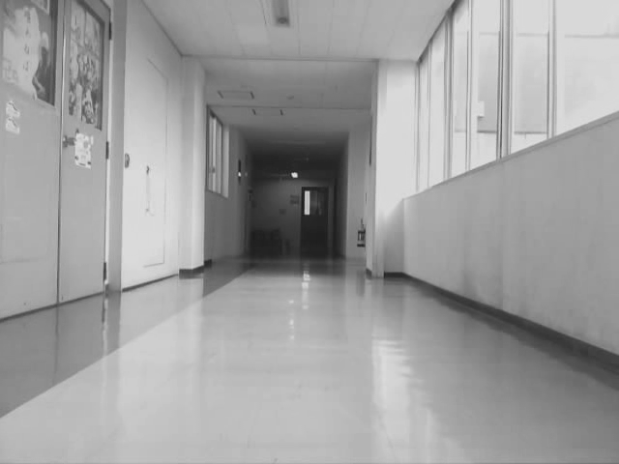
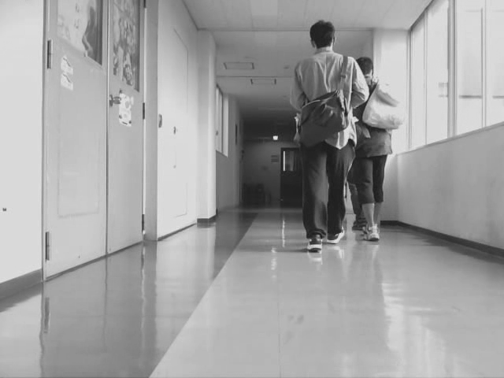
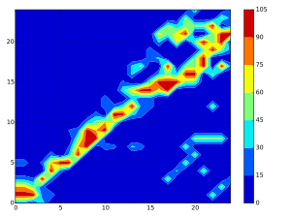
特徴点の相互相関
f(I'j, St) = (g1, …, gi, …, gm)
gi：I'jとIiとの対応強度
gi ∈ ℕ
「教示」画像シーケンス
St = [I1, ..., Im]
「再生」画像シーケンス
Sr = [I'1, ..., I'n]
対応マップ
…
100
…
100
…
100
…
...
...
「教示」画像のインデックス
f(I'1, St)
...
f(I'j, St)
...
f(I'n, St)
「再生」画像のインデックス
Notes:
Let's start with two image sequences, a teach sequence recorded from the teach step, and a replay sequence recorded during the current replay step.
Now assume we have a function f() that returns a vector of positive integers representing the similarities between each replay image j and all teach images i. I will discuss how to define this function later. For now let's just assume that this function is “good” but not “perfect”: that is, in general it does return higher values for more closely related image pairs and lower values otherwise, but sometimes it may produce dubious or plain incorrect results.
If we compute these vectors for each replay image, arrange them in columns and plot a contour map of the resulting matrix, we'll likely get a result like this. In this map hotter colors indicate higher similarity and colder colors, lower.

Slide 9
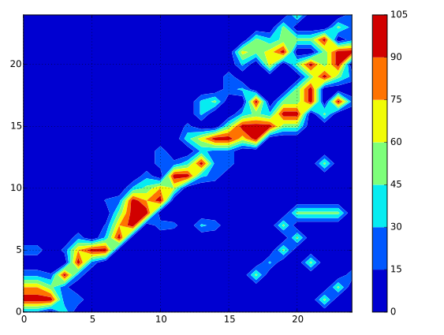
特徴点の相互相関
対応マップ
「教示」画像のインデックス
「再生」画像のインデックス
Notes:
Let's take a closer look at this similarity map. It's easy to see that for example, image 10 in the replay sequence is most similar to image 9 in the teach sequence. Other cases are more dubious: replay image 17 could be paired to either teach image 16 or 23. However, assuming the robot is always moving forward on both steps, it couldn't really be teach image 23, since the following replay images are clearer related to earlier teach images.
If we assume the robot was moving at a constant pace on both steps, then it makes sense to look for a linear correlation between teach and replay images. We can take a brute force approach and draw lines over the similarity map until we find a line that passes over the highest number of good matches, then use this line to relate teach and replay images. For example, with this approach we'd match replay image 17 to teach image 16, which was not a strong match but is a consistent assignment.

Slide 10
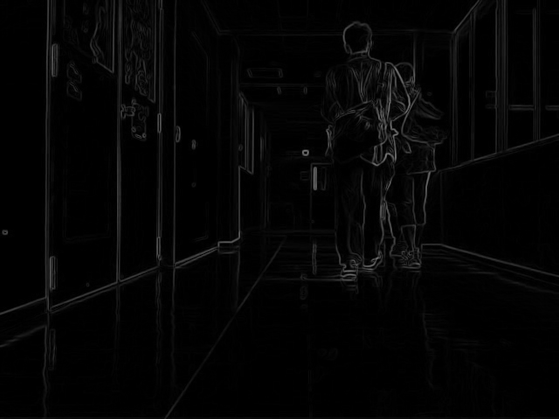
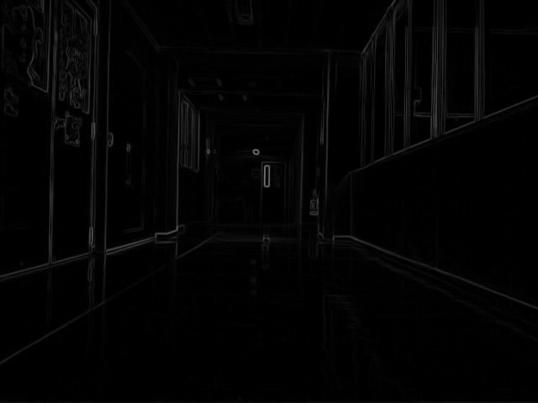
特徴点の相互相関
「再生」画像I'j
「再生」マップH'j
p'j,k
P(z, H'j) = [p'j,1, ..., p'j,z]
p：特徴点
p'j,k = (xj,k, yj,k)
C'j = [c'j,1,... , c'j,z]
c：相互相関のための去領域
c'j,k = H'j[p'j,k - α : p'j,k + α]
c'j,k
η
p'j,k
Ci,j = [ci,j,1,... , ci,j,z]
ci,j,k = Hi[p'j,k - β : p'j,k + β]
Qi,j = [qi,j,1,... , qi,j,z]
q：ci,j,kとc'j,kとの対応強度
qi,j,k = max(ci,j,k ⭑ c'j,k)
ci,j,k
η
「教示」画像Ii
「教示」マップHi
Notes:
Now if you remember, when we started we assumed the existence of a function f() that compares individual replay images to the whole teach record. So now let's go back and define function f().
First let's see how we can compare a single replay and teach image. In order to reduce the impact of differences in lighting, we first apply a mapping transform to both images, for example the Sobel edge filter. Next, we take the replay map and apply a feature detector, for example a corner detector, and select a subset of some fixed number z. Around each detected feature in the replay image, we carve out a small patch of side alpha.
Now we take the teach image and carve out larger patches of side beta around the same coordinates as the features detected in the replay image. Again, on the teach image we don't detect features, we just take the coordinates of the features detected in the replay image and use them again. The patches from the replay and teach images are paired by feature coordinates. Then we calculate a vector Q of matching values: each cell in the vector is the maximum response of the cross-correlation between a patch from the replay image and its correspondent in the teach image.

Slide 11
特徴点の相互相関
I1
8 | 43 | 46 | 79 | 117
220 | 416 | 385 | 432 | -72
21 | 71 | 62 | 68 | 31
-40 | -27 | 36 | 13 | 147
-304 | -23 | -316 | -316 | -423
-69 | 282 | 373 | 285 | 104
0 | 0 | 0 | 0 | -19
597 | -173 | 95 | -57 | 11
61 | 47 | 62 | 175 | 50
24 | 151 | -18 | 25 | -105
0
3
0
1
0
0
0
1
0
0
I2
I3
「再生」マップ
I4
I5
「教示」画像Ii
I6
I7
I8
I9
I10
「教示」マップ
シーケンス
p'j,1
p'j,2
p'j,3
p'j,4
p'j,5
f(I'j, St)
「再生」画像I'jの特徴点
Notes:
If we take a single replay image and repeat this procedure for every teach image, we end up with a matrix relating each feature in the replay image to each image in the teach record. Each column tells how well a replay image feature matched each teach image. If for each column we mark the maximum value, then count the number of maximum values in each row, we end up with a vector describing how well the replay image is matched to each teach image. This is our definition of the function f().

Slide 12
目次
自律走行について「教示・再生」
特徴点の相互相関による対応画像の発見
実験結果
まとめ
Notes:
Let's see how well the method described so far works.

Slide 13
実験結果
システムパラメーター
  並進速度 v = 0.3m/s
  画像サイズ640x320、入力周波数1Hz（毎秒1画像）
  推定に用いる画像シーケンス の数m = n = 25
  パラメーター(α, β, z) = (30, 90, 10)
実験環境・経路
「屋外」実験
「屋内」実験
「教示」ステップ
「再生」ステップ
2°
「再生」ステップ
-2°
「教示」ステップ
15m
20m
Notes:
All field test procedures were performed under the same system parameters as shown here.
Two test environments were selected, one outdoors, one indoors. The outdoors environment is the paved way through building D of the University of Tsukuba; the indoors environment is the corridor in front of room D402. For each environment two runs were recorded for offline processing. In the outdoors environment the second run differed from the first by a yaw 2 degrees to the right, and in the indoors environment, two degrees to the left. The outdoors test had to be limited to a 15m straight run to avoid reaching a patch of especially rough terrain; the indoors test was allowed to run for 20m.

Slide 14
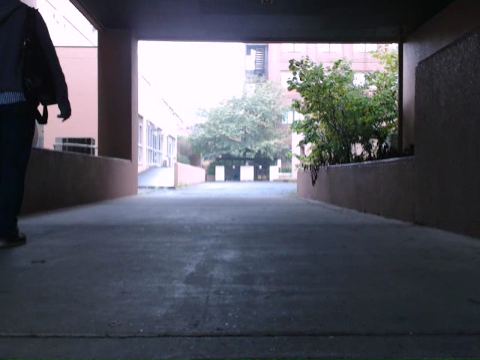
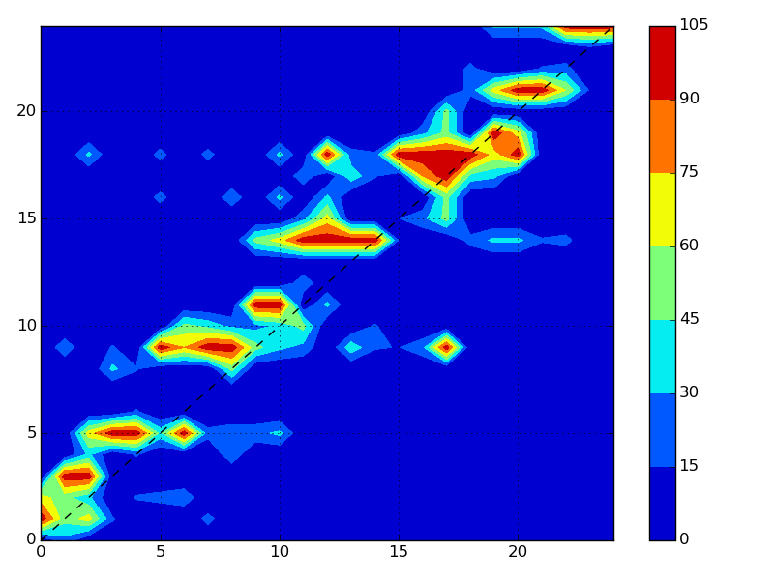
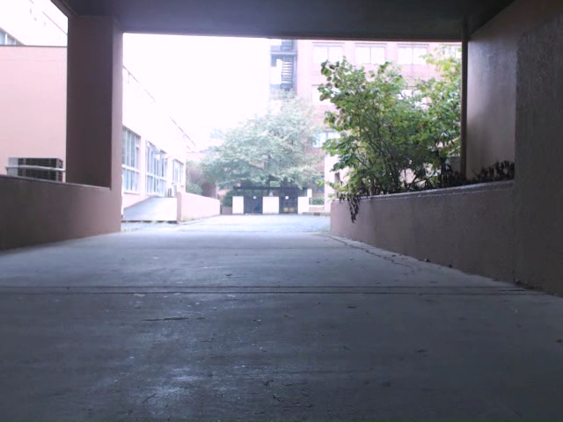
実験結果
「屋外」実験
教示
「教示」画像のインデックス
再生
「再生」画像のインデックス
ほぼ良い結果
Notes:
Results for the outdoors test were remarkably good, considering the relative lack of distinct features in this environment. The similarity map was rather sparse, with interspersed islands of good matches, but even so the estimated image pairing, represented here by this dashed line crossing the similarity map, agreed very well with pairing performed by a human (in this case, me).

Slide 15
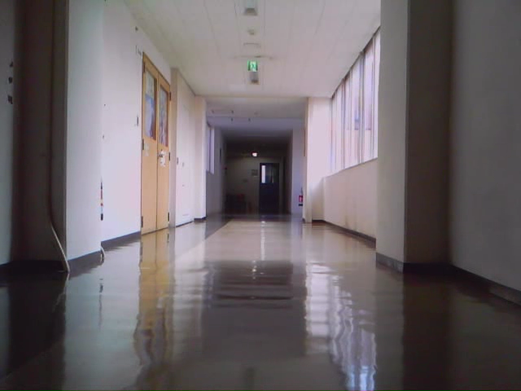

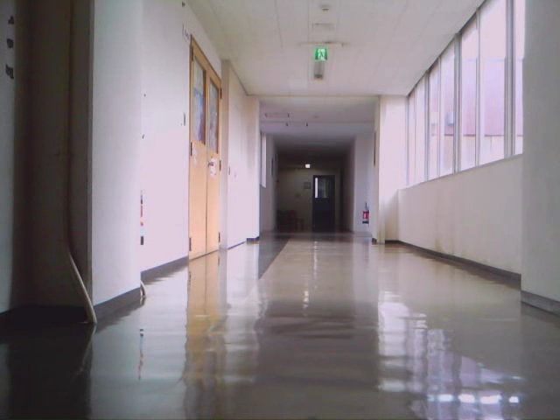
実験結果
「室内」実験
教示
「教示」画像のインデックス
再生
「再生」画像のインデックス
良い結果
画像シーケンスの不対応は少ない
Notes:
Results were more dubious for the indoors environment. The similarity map was denser, but the line sequence correlation computed over it was somewhat divergent from a manual evaluation. However this was still a good enough result for the purposes of pairing up images for use with DiVS.

Slide 16
目次
自律走行について「教示・再生」
特徴点の相互相関による対応画像の発見
実験結果
まとめ
Notes:
All that's left is conclusions.

Slide 17
まとめ
特徴点の相互相関は画像シーケンスから対応を作る
対応は安定、環境の変化にロバスト
今後の予定
  さらに実験
  パフォーマンス向上
  他の線フィッティング方法をやってみる（例：RANSAC）
Notes:
Feature point correlation is a method for pairing up images from different sequences. During tests it produced consistent results against changes in lighting, occlusion and the presence of moving elements.
From this point on my intention is to further evaluate the method, especially over longer routes and varying speeds, improve runtime performance so it can be used in real-time, and also experiment with other methods to extract the image correlation from the similarity map, for example using RANSAC.

Slide 18
終わり
以上
Notes:
This is the end of my presentation. Any questions?

